Slide 1
Cheat
Sheet
-by Dani

Slide 2

Why
'cos can
Structuring material
Forgetting most
Future access

Slide 3
How to do it?
Record it on .mp3
Create a Slide-Show
Write on Paper
Doodle
Whatever works for you

Slide 4
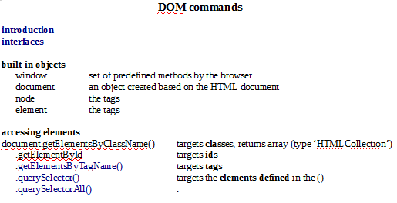
How I do it?

Slide 5
Succesful Cheating!
Thank you!

